Slide 1
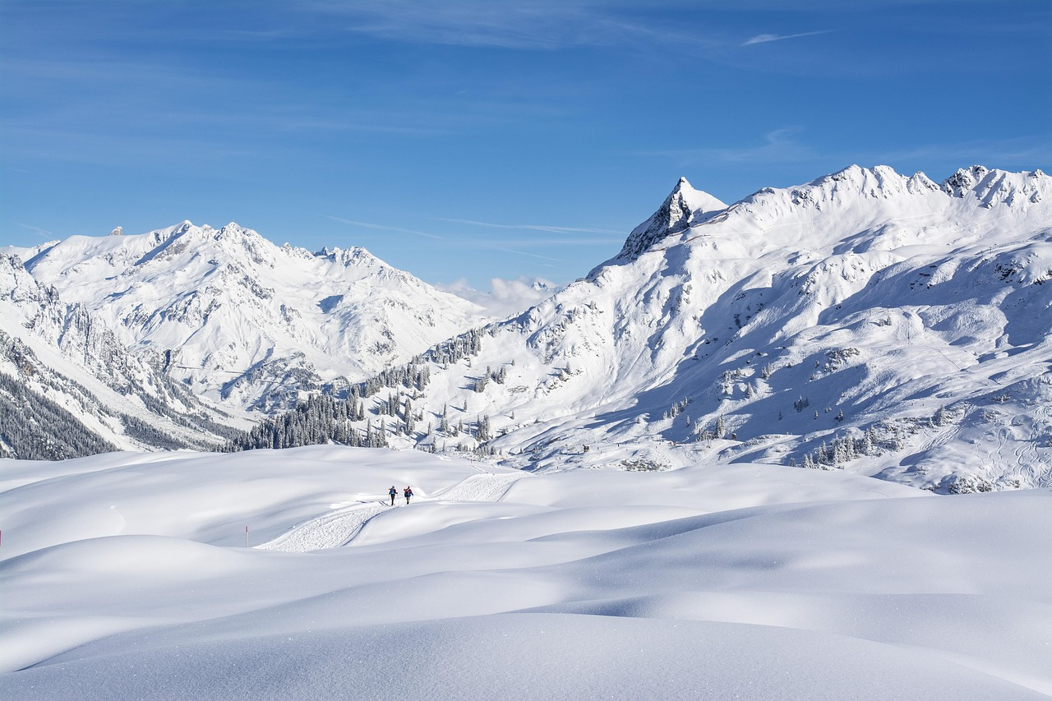
A Ticket Pricing Model for Big Mountain Resort

Slide 2
PART ONE
Problem Identification
Big Mountain’s pricing strategy has been to charge a premium above the average price of resorts in its market segment.
Big Mountain Resort has recently installed an additional chair, increasing the operating costs by $1,540,000 this season.
Are we capitalizing on our facilities as much as we could? What facilities matter most to visitors?
How can we increase our profits? Increasing our ticket price? Cutting our operating costs?
A ticket pricing model based on a resort’s facilities

Slide 3
PART TWO
Recommendation and Key Findings
Modeled Price
$ 95.87
MAE $10.39
Current Price
$ 81
adding a run, increasing the vertical drop by 150 feet
installing an additional chair lift
Increase ticket price by $1.99, increase revenue by $3474638
Notes:
Big Mountain Resort’s modeled price is $95.87, the actual price is $81.00. Even with the expected mean absolute error of $10.39, this suggests there is room for an increase.
To increase the revenue, our model suggests adding a run, increasing the vertical drop by 150 feet, and installing an additional chair lift. This scenario increases support for ticket price by $1.99. Over the season, this could be expected to amount to a $3474638 increase in revenue.

Slide 4
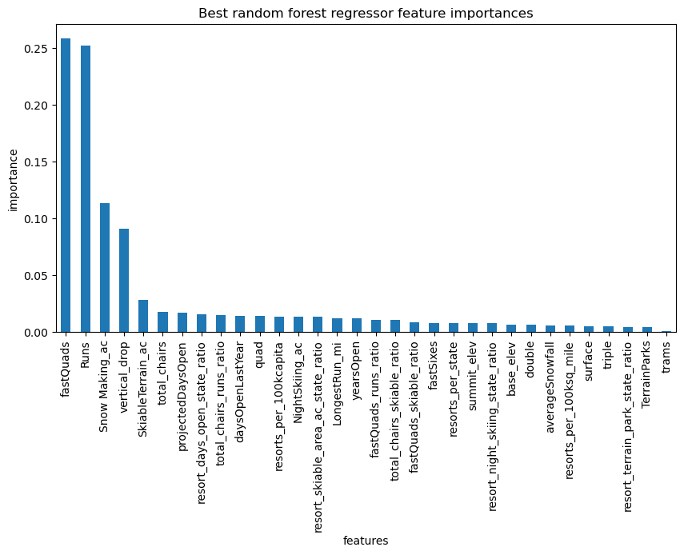
PART THREE
Modeling results and Analysis
Top 4 important features
The number of fast four-person chairlifts
Total area covered by snow-making machines in acres
Count of the number of runs on the resort
Vertical change in elevation from the summit to the base in feet

Slide 5
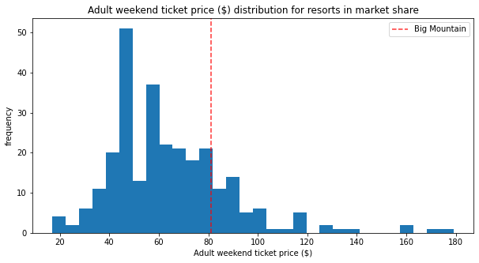
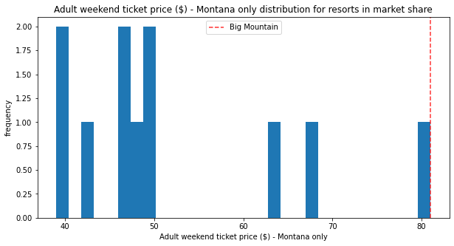
PART THREE
Modeling Results and Analysis
The current price ($81 ) of Big Mountain is relatively expensive in the country and is the most expensive in Montana

Slide 6
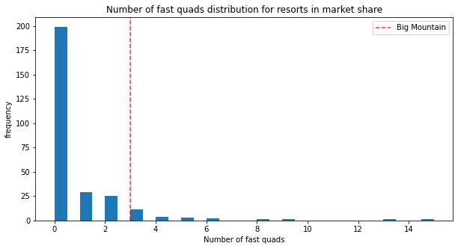
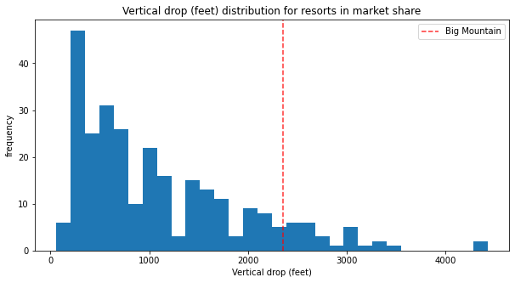
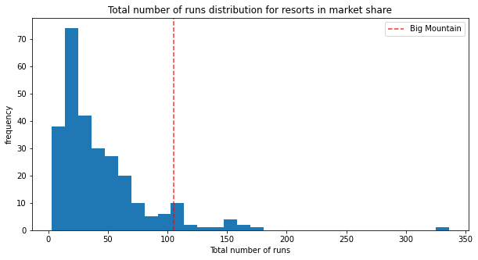
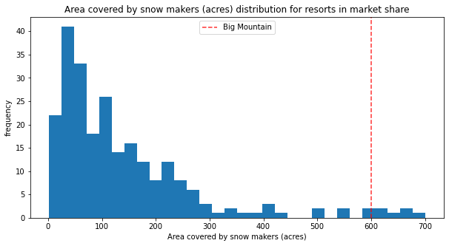
PART THREE
Modeling Results and Analysis
Big Mountain is worth the high price

Slide 7
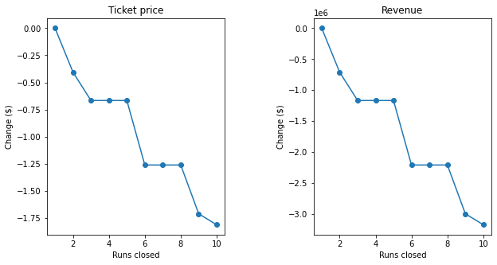
PART THREE
Modeling Results and Analysis
2 Increase the vertical drop by adding a run to a point 150 feet lower down with an additional chair lift
Increase ticket price by $1.99, increase revenue by $3474638
1 Permanently closing down up to 10 of the least used runs
3 Same as number 2, but adding 2 acres of snow making cover
Increase ticket price by $1.99, increase revenue by $3474638
4 Increase the longest run by 0.2 mile to boast 3.5 miles length, requiring an additional snow making coverage of 4
No impact on ticket prices

Slide 8
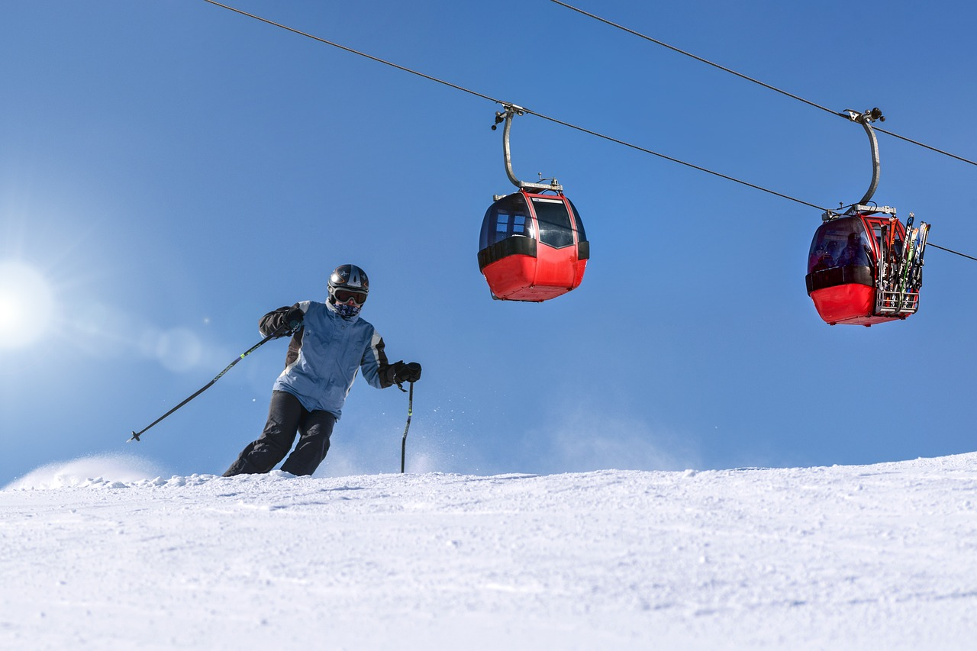
PART FOUR
Summary and conclusion
Given Big Mountain’s existing facilities, raising ticket prices to cover the increased operating cost is imperative.
The ticket pricing model can be used as a reference for further investment in facilities.

